Slide 1



www.bjitgroup.com
CloudKit

Slide 2
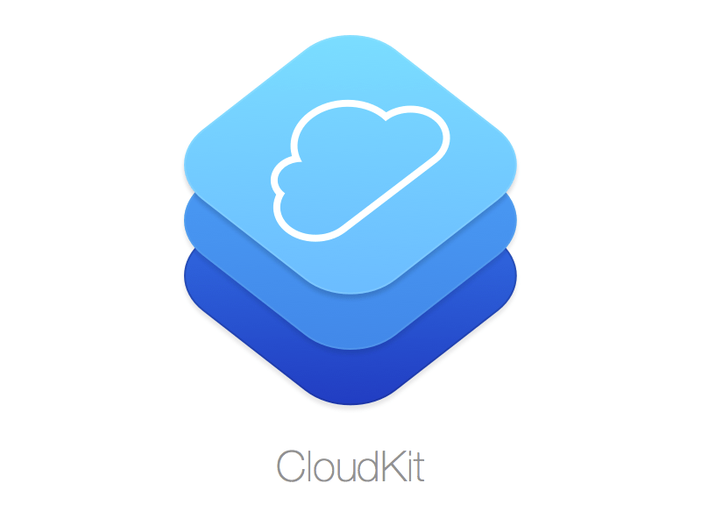
Getting Started
CloudKit is Apple’s remote data storage service. Based on iCloud, it provides a low-cost option to store and share app data using your users’ iCloud accounts as a back-end storage service.
With CloudKit, users’ private data is completely protected because developers can only access their own private databases and aren’t able to look at any user’s private data.
There are two main components to CloudKit:
A web dashboard to manage record types and any public data.
A set of APIs to transfer data between iCloud and the device.

Slide 3
Why CloudKit?
Unlike other back-end solutions, CloudKit requires little setup. You don’t have to choose, configure or install servers. Apple handles security and scaling as well.
Simply registering for the iOS Developer Program makes you eligible to use CloudKit. You don’t have to register for additional services or create new accounts.
When you enable CloudKit capabilities in your app, all necessary server setup magic happens automatically.
Another benefit of CloudKit is that users can trust the privacy and security of their data by relying on Apple rather than app developers. CloudKit insulates user data from you, the developer.
While this lack of access can be frustrating while debugging, it’s a net plus since you don’t have to worry about security or convince users their data is secure.
If an app user trusts iCloud, then they can also trust you.
Finally, the cost of running a service is a huge deal for any developer. Even the least-expensive server hosts can’t offer low-cost solutions for small, free or cheap apps. So, there will always be a cost associated with running an app.
With CloudKit, you get a reasonable amount of storage and data transfer of public data for free.
There’s a handy calculator on Apple’s CloudKit site.
Simplicity
Trust
Cost

Slide 4
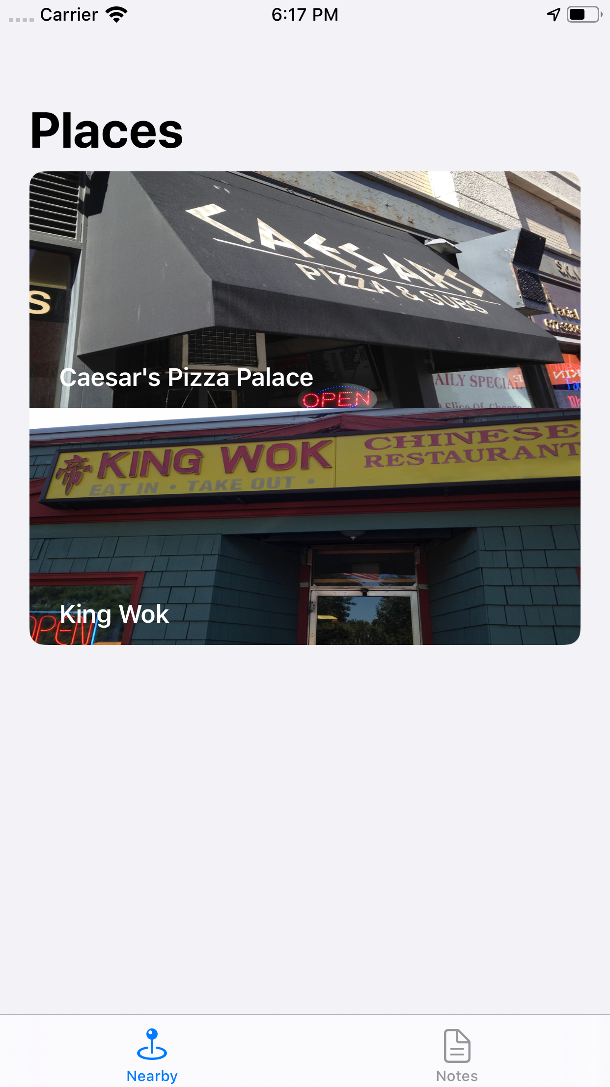
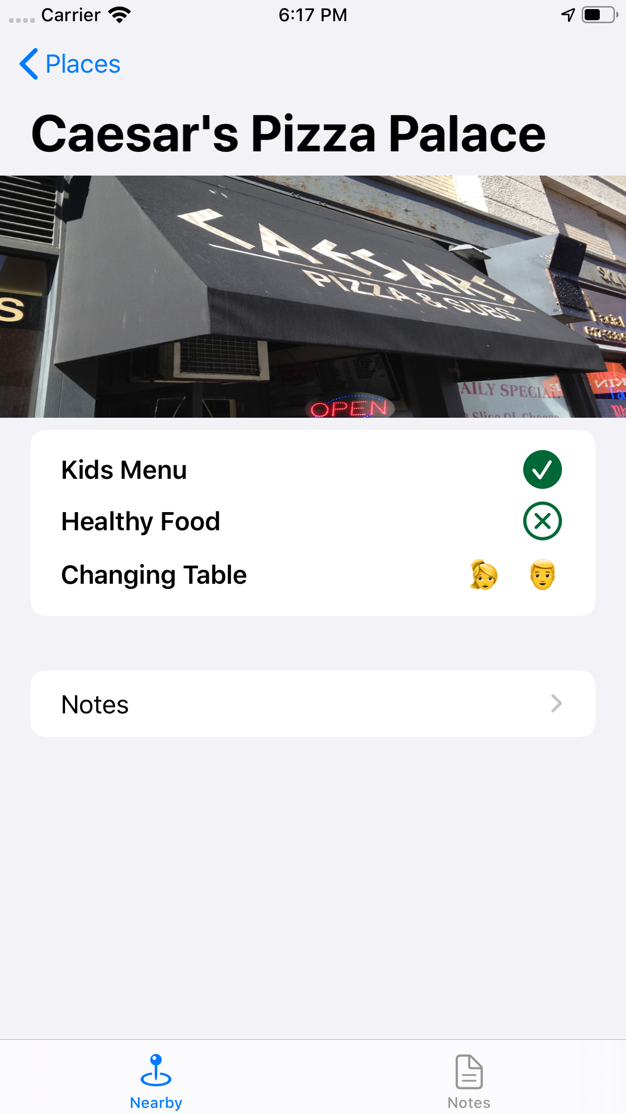
Introducing BabiFüd
The sample app for this CloudKit tutorial, BabiFüd, is the freshest take on the standard “rate a restaurant” app.
Instead of reviewing restaurants based upon food quality, speed of service or price, users rate child-friendliness.
This includes the availability of changing facilities, booster seats and healthy food options.
The app contains two tabs: A list of nearby restaurants and user-generated notes. You can get a glimpse of the app in action below.
A model class backs these views and wraps the calls to CloudKit. CloudKit objects are called records. The main record type in your model is an Establishment, which represents the various restaurants in your app.

Slide 5
Download Materials
Download the materials of this tutorial to download the starter project from the link below.
You’ll have to change the Bundle Identifier and Team of your app before you can start coding.
You need to set the team to get the necessary entitlements from Apple, while having a unique bundle identifier makes the process a whole lot easier.
https://koenig-media.raywenderlich.com/uploads/2019/09/CloudKit-1.zip

Slide 6
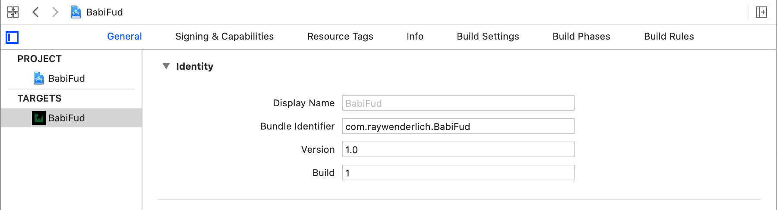
Download Materials
Open BabiFud.xcodeproj in Xcode. Select the BabiFud project in the Project navigator, then select the BabiFud target.
With the General tab selected, replace the Bundle Identifier with something unique.
Standard practice is to use reverse domain name notation and include the project name.
That takes care of the Bundle Identifier. Now, you’ll need to get your app set up for CloudKit and create some containers to hold your data.

Slide 7
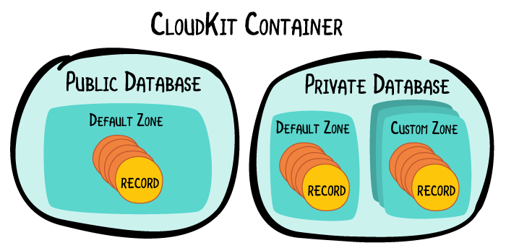
Entitlements and Containers
You’ll need a container to hold the app’s records before you can add any data via your app.
A container is the term for the conceptual location of all the app’s data on the server.
It’s a group of public and private databases.

Slide 8
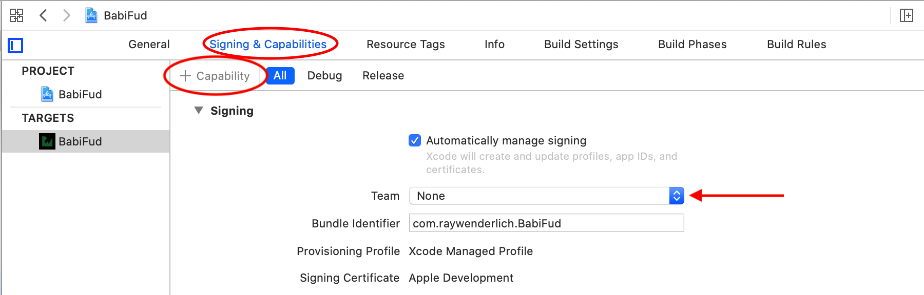
Entitlements and Containers
Select the Signing & Capabilities tab in the target editor.
Click on + Capability.
Choose iCloud.
Select your Team from the drop-down.
At this point, Xcode might prompt you to enter the Apple ID associated with your iOS developer account. If so, then type it in as requested.
To create a container, you first need to enable the iCloud entitlements for your app:

Slide 9
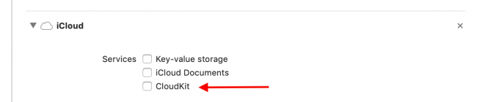
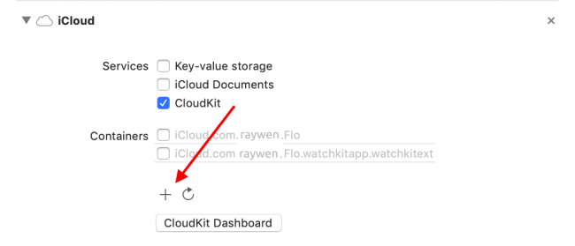
Entitlements and Containers
Next, enable CloudKit by checking the CloudKit checkbox in the Services group.
Finally, click on + under Containers to add a new container, if CloudKit didn’t automatically create one for you.

Slide 10
When integrating CloudKit into your app, the choice of which option to use for storage (key-value storage, iCloud documents, or CloudKit) will depend on the specific needs of your app and the type of data you are storing.
Key-Value Storage: Use this option if you need to store small amounts of data, such as preferences or settings, that need to be kept in sync across all of a user's devices.
iCloud Documents: Use this option if you need to store larger files and data, such as documents or images, that should be kept in sync across all of a user's devices.
CloudKit: Use this option if you need to store structured data in a way that can be queried and shared with other users. CloudKit also allows for easy handling of user authentication and access control.
It is possible to use combination of them depends on requirement of the app.
It's also a good idea to read the documentation from Apple to get more detailed information about CloudKit, and to decide which option is best for your app.

Slide 11
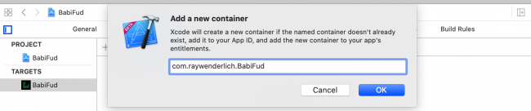
Entitlements and Containers
In the pop-up, add your bundle identifier.
This creates a default container named iCloud.<your app’s bundle ID>.
Note: At the time of writing, CloudKit containers cannot be deleted. Keep in mind that if you create a new container for this tutorial, it will live on forever in your CloudKit Dashboard.

Slide 12



Troubleshooting iCloud Setup in Xcode
The iCloud container name must be unique because this is the global identifier used by CloudKit to access the data. Since the iCloud container name contains the bundle ID, the bundle ID must also be unique. This is why you cannot use com.raywenderlich.BabiFud and you had to change it earlier.
If you see any warnings or errors related to the container ID when creating entitlements, building the project or running the app, here are some troubleshooting tips:
The app’s bundle ID and iCloud containers must match, and they must exist in the developer account. For example, if the bundle identifier is com.<your domain>.BabiFud, then the iCloud container name should be iCloud. plus, the bundle bundle id: iCloud.com.<your domain>.BabiFud.
If there are any warnings or errors shown in the Steps group in the iCloud section, try pressing the Fix Issue button. You might need to do this a few times.

Slide 13
Troubleshooting iCloud Setup in Xcode
For the entitlements to work, the app/bundle ID has to appear in the App IDs portion of the Certificates, Identifiers and Profiles portal. This means the certificate used to sign the app has to be from the set team ID and has to list the app ID, which also implies the iCloud container ID.
Normally, Xcode does all of this automatically if you are signed into a valid developer account. Unfortunately, this sometimes gets out of sync.
It can help to start with a fresh ID and, using the iCloud capabilities pane, change the CloudKit container ID to match. Otherwise, you may have to edit the Info.plist or BabiFud.entitlements files to make sure the ID values there reflect what you set for the bundle ID.

Slide 14
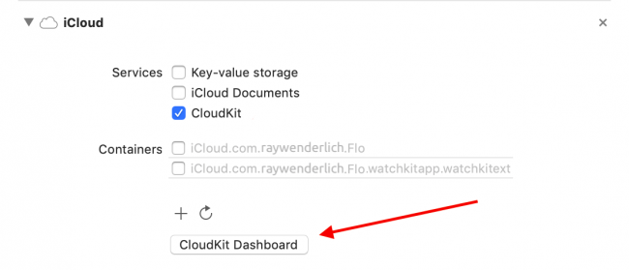
Introducing the CloudKit Dashboard
Next step is to create some record types that define the data that your app will use. You can do this using the CloudKit dashboard.
Click CloudKit Dashboard, which you can find in the target’s Signing & Capabilities pane, under iCloud or by opening https://icloud.developer.apple.com/dashboard/ in your browser.
Note: It sometimes takes a while for a new app’s container to show up in the dashboard. If you don’t see your container right away, wait a few minutes and try again.

Slide 15
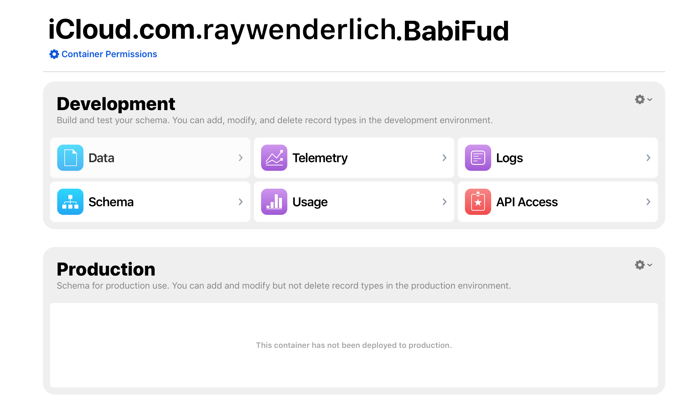
Introducing the CloudKit Dashboard
Here’s what the dashboard looks like:
The CloudKit dashboard consists of six sections:
Data
Schema
Telemetry
Usage
Logs
API Access

Slide 16
Introducing the CloudKit Dashboard
The Schema section represents the high-level objects of a CloudKit container: Record Types, Indexes, Security Roles and Subscription Types. You’ll only deal with Record Types in this tutorial.
A Record Type is a set of fields that defines individual records. In terms of object-oriented programming, a Record Type is like a class. You can think of a record as an instance of a particular Record Type. It represents structured data in the container, much like a typical row in a database, and encapsulates a series of key/value pairs.
Under Data, the Private Database and Public Database sections let you add data to, or search for, data in the databases you have access to. Remember, as a developer you can access all public data, but only your own private data.

Slide 17
Introducing the CloudKit Dashboard
The User Records store data, such as name and email, about the current iCloud user.
You use a Record Zone, noted here as the Default Zone, to provide a logical organization to a private database by grouping records together.
Custom zones support atomic transactions by allowing you to save multiple records at the same time before processing other operations. Custom zones are outside the scope of this tutorial.
The API Access section provides the ability to configure the dashboard permissions for your team members. If you have multiple development team members, you can restrict their ability to edit data here. This, too, is out of scope for this tutorial.

Slide 18
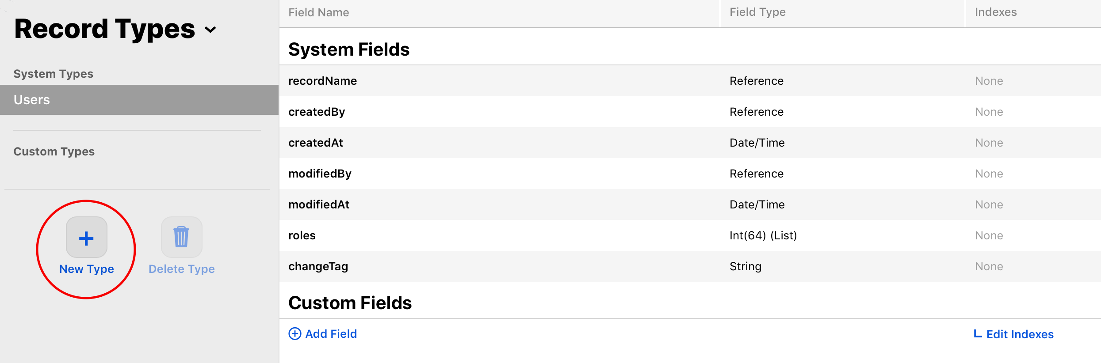
Adding the Establishment Record Type
Think about the design of your app for a moment. The establishments you track each have lots of data: Name, location and availability of child-friendly options. Record types use fields to define the various pieces of data each record contains.
Under Schema, select Record Types and then New Type to add a new record type.
Name your new record type Establishment, then press Enter.

Slide 19
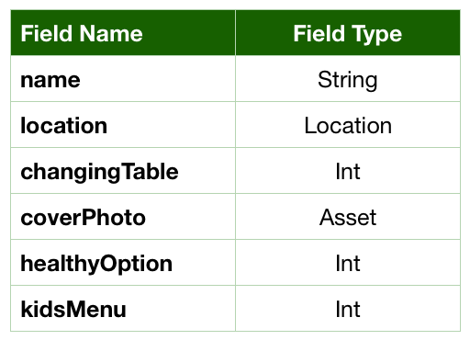
Adding the Establishment Record Type
You’ll see a row of system fields, automatically created for every record type. Each one has a Field Name, a Field Type and an Index.
Of course, you can add your own fields. Start by selecting Add Field, call it name, and set the Field Type to String.
Repeat until you have added all these fields:
Click Save at the bottom of the page to save your new record type.

Slide 20
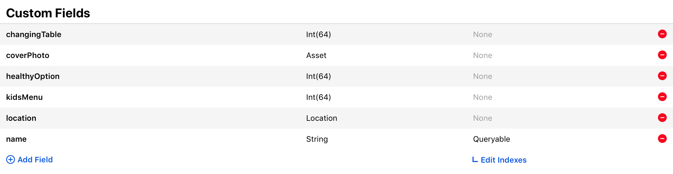
Adding the Establishment Record Type
Next, click Edit Indexes. You’re going to add two indexes so that you can query your records:
recordName with the index type of QUERYABLE.
name with the index type of QUERYABLE.
You need to make recordName queryable by default. You set name to queryable so you can query records based on a specific name.
Click Save Changes at the bottom of the page to save your indexes.
When you’re done, your list of fields should look like this:

Slide 21
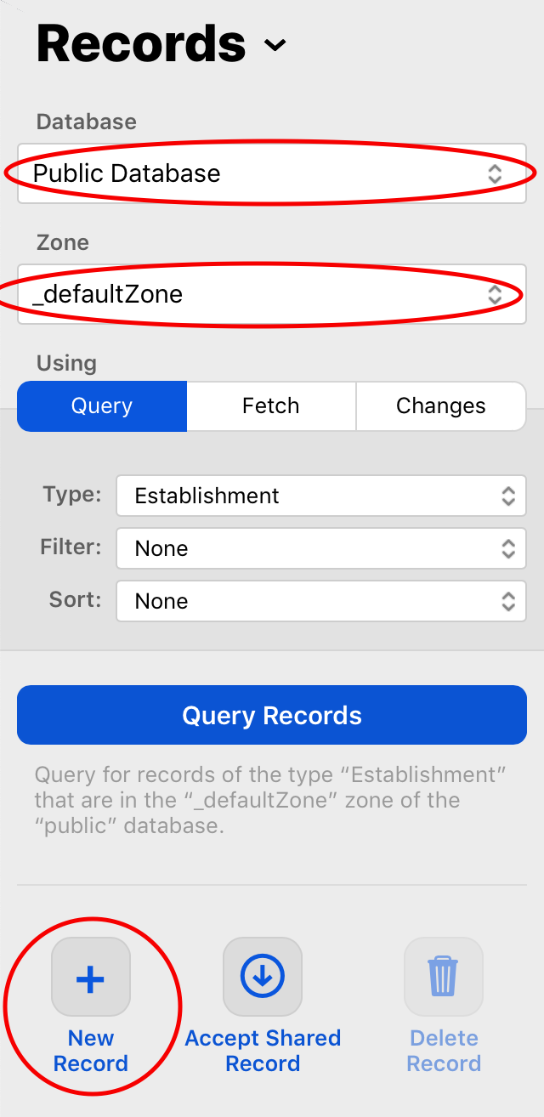
Adding the Establishment Record Type
Select _defaultZone under the Public Database section in the navigation pane on the left.
This zone will contain the public records for your app.
Select the Establishment record type from the drop-down list in the center pane, if it’s not already selected.
Then click the New Record button in the bottom detail pane, as shown in the screenshot below:

Slide 22
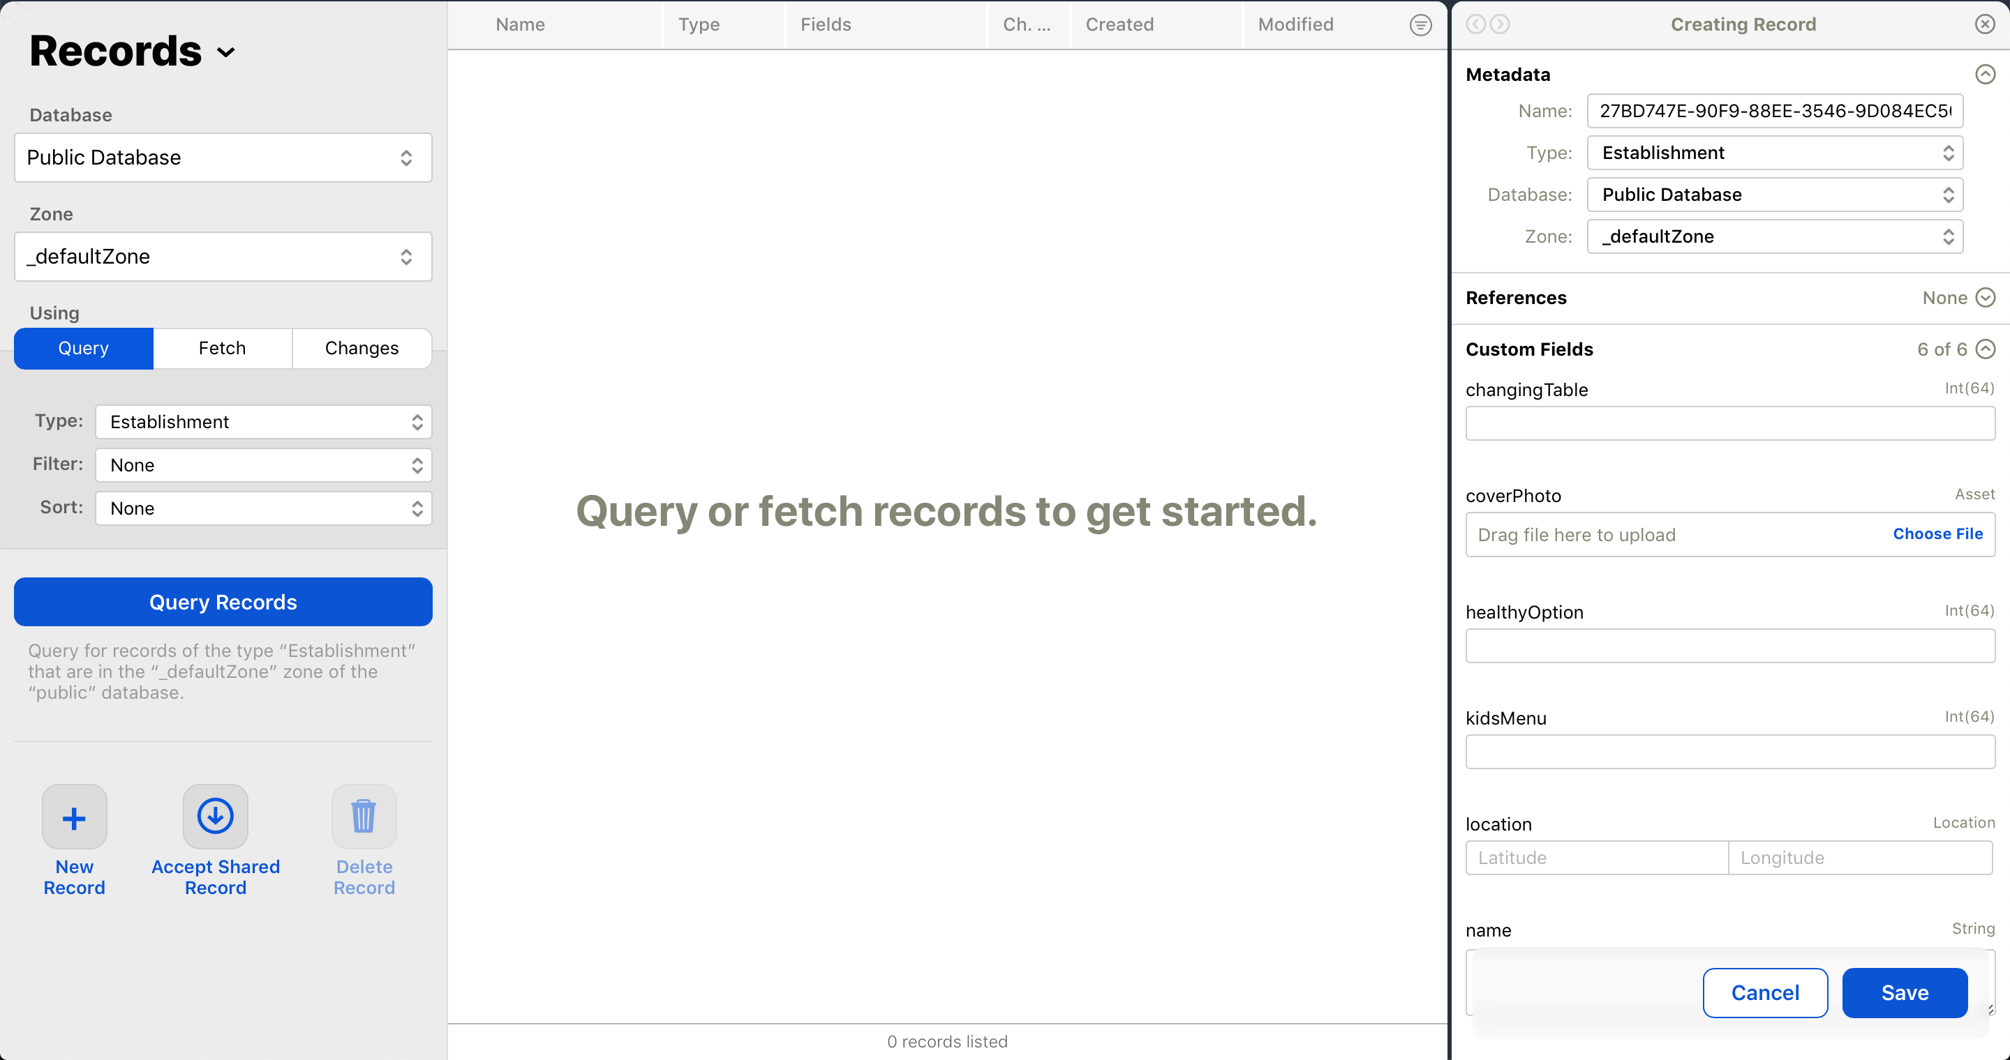
Adding the Establishment Record Type
This will create a new, empty Establishment record.

Slide 23
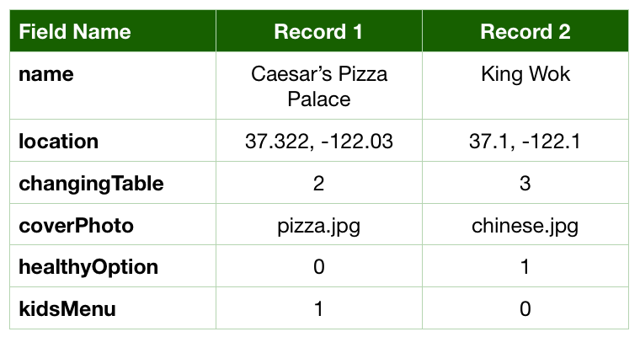
Adding the Establishment Record Type
At this point, you’re ready to enter some test data for your app.
The following sample establishment data is fictional. The establishments are located near Apple’s headquarters, so they’re easy to find in the simulator.
Enter each record as described below:
You’ll find the images in the materials file containing the starter project, which you downloaded earlier. Look for the Images folder.

Slide 24
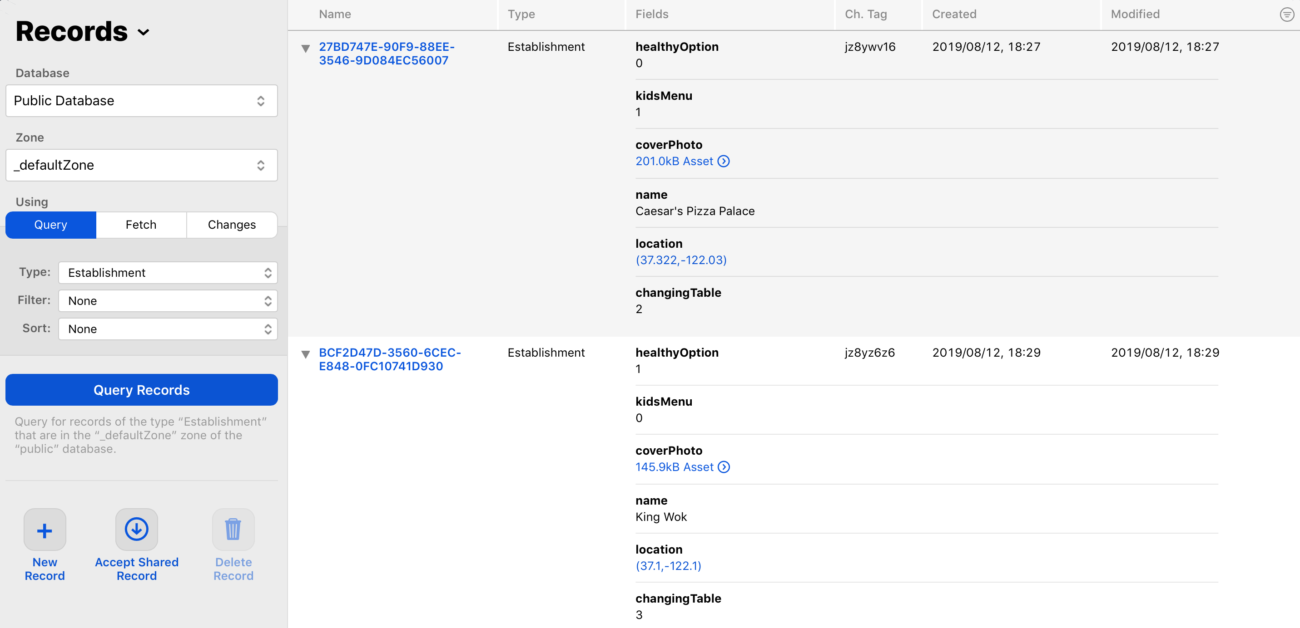
Adding the Establishment Record Type
Once you’ve saved all the records, the dashboard should look like this. You might need to click the Query Records button to make the records appear:
For each record, the entered values are the database representation of the data.

Slide 25
Adding the Establishment Record Type
On the app side, the data types are different. For example, ChangingTable is an enum. So, the specified Int value for changingTable might correspond to a changing table being available in the men’s or women’s room.
For healthyOption and kidsMenu, the Int values represent Boolean types: A 0 means that establishment doesn’t have that option and a 1 means that it does.
To run the app, you need to have an iCloud account that you can use for development. You’ll find instructions here: Creating an iCloud Account for Development.
You’ll also need to enter the iCloud credentials associated with this account into the iOS Simulator: Enter iCloud Credentials Before Running Your App
Return to Xcode. It’s time to start integrating this data into your app!

Slide 26
Querying Establishment Records
To select records from a database, you’ll use CKQuery. A CKQuery describes how to find all records of a specific type that match certain criteria. These criteria can be something like “all records with a Name field that starts with ‘M’”, “all records that have booster seats” or “all records within 3 km”.
iOS uses NSPredicate to handle these kinds of expressions. NSPredicate evaluates objects to see if they match the criteria. Predicates are also used in Core Data; they’re a natural fit for CloudKit because the definition of a predicate is simply a comparison on a field.
CloudKit supports only a subset of available NSPredicate functions. These include mathematical comparisons, some string and set operations such as “field matches one of the items in a list”, and a special distance function. The CKQuery Class Reference contains a detailed list of the functions that CloudKit supports as well as descriptions of how to use them.

Slide 27
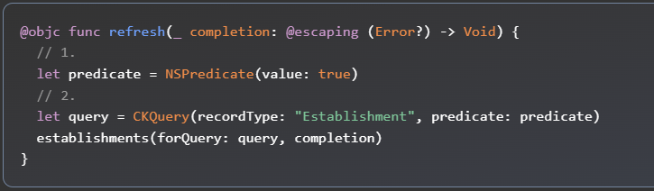
Querying Establishment Records
In Xcode, open Model.swift. Replace refresh(_:) with the following implementation:
Here’s what you’ve added:
You create a predicate with the value true. NSPredicate determines how you fetch or filter data; in this case, you’re specifying that a value should just exist.
You add a query to specify which type of record you want and a predicate.

Slide 28
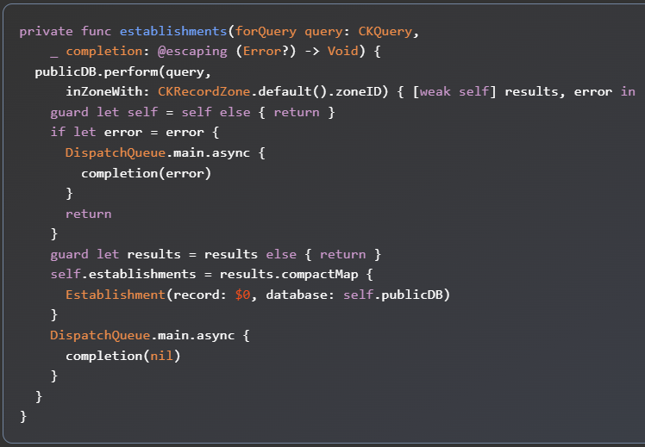
Querying Establishment Records
Next, replace establishments(forQuery:_:) with the following:
Since you’re passing the CKQuery object here, your public database, publicDB, can perform the query.
If you think back to when you created the two Establishment objects in the CloudKit dashboard, you put them in the public database, in the default container.
That’s exactly what inZoneWith’s parameter is specifying here. Now, the database will query any Establishment records that exist in the public database.
Code Link

Slide 29
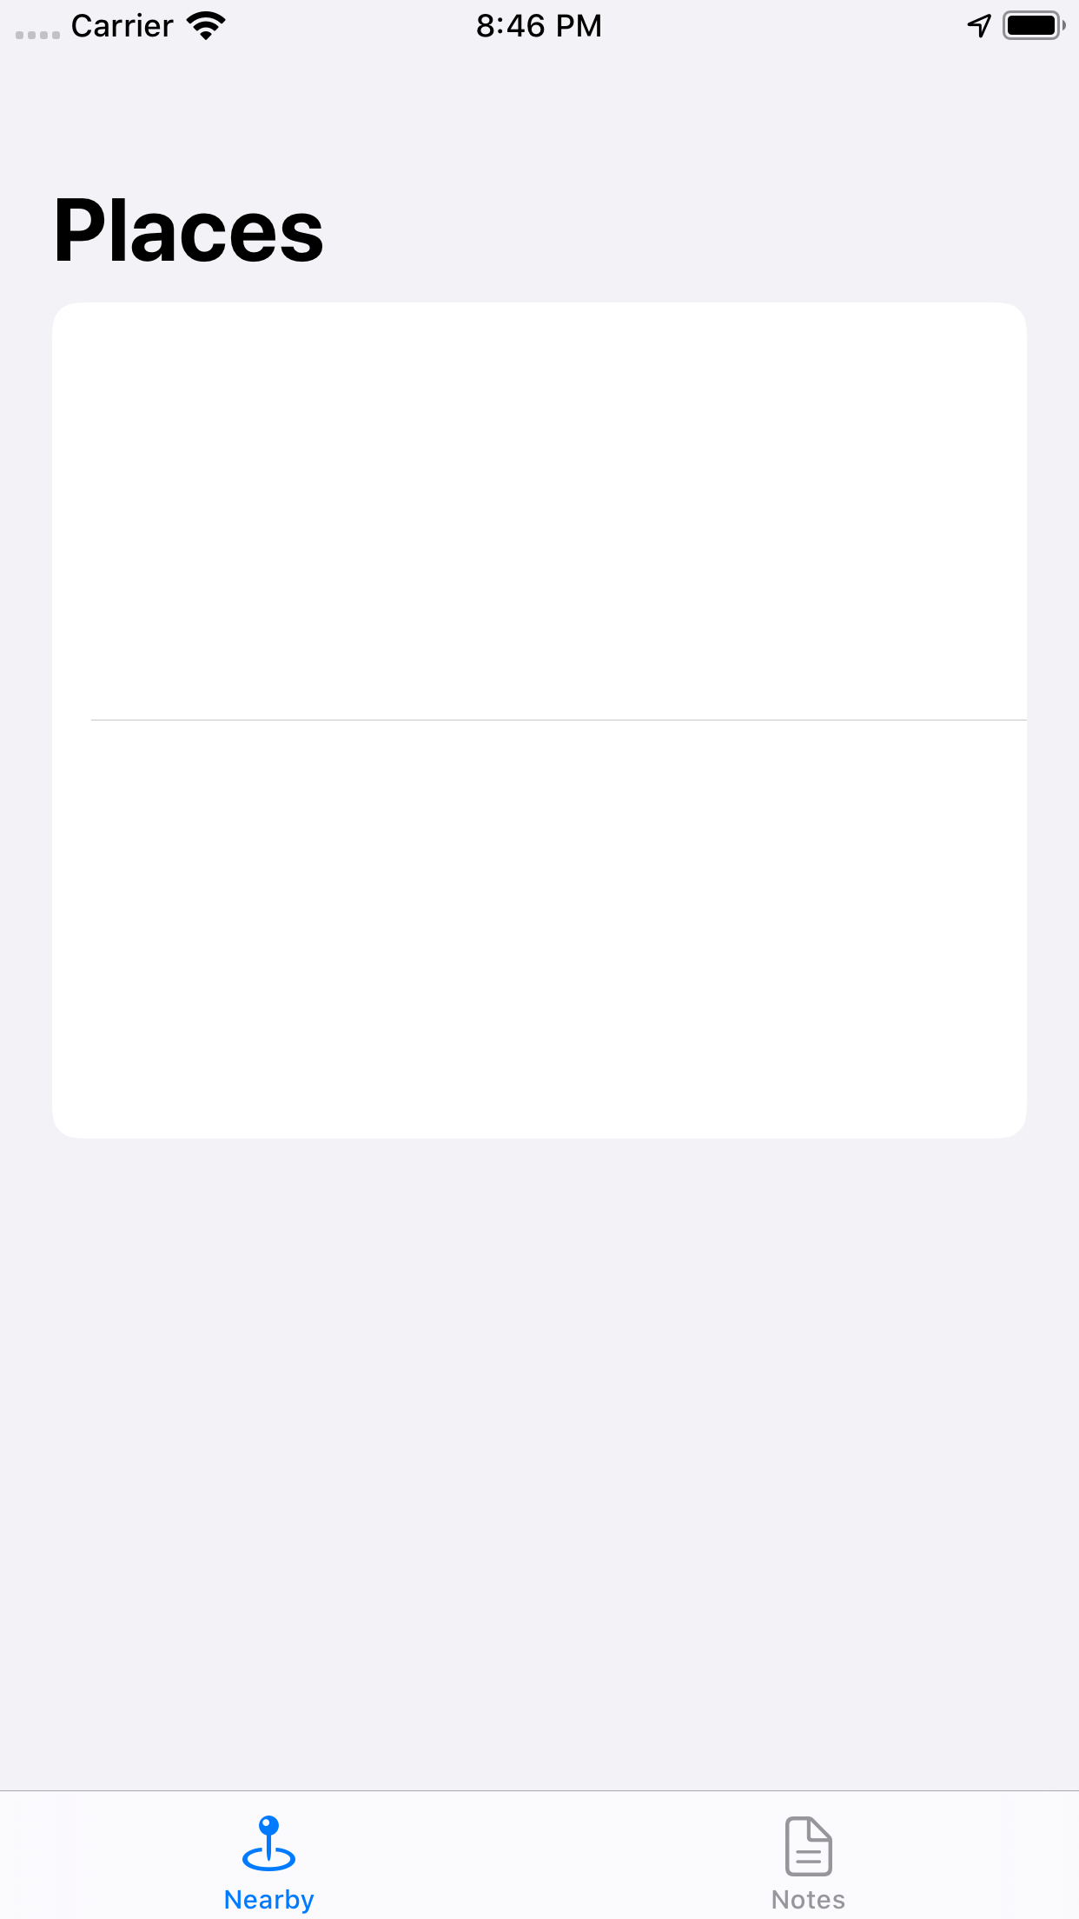
Querying Establishment Records
Build and run. You should see a list of nearby establishments.

Slide 30
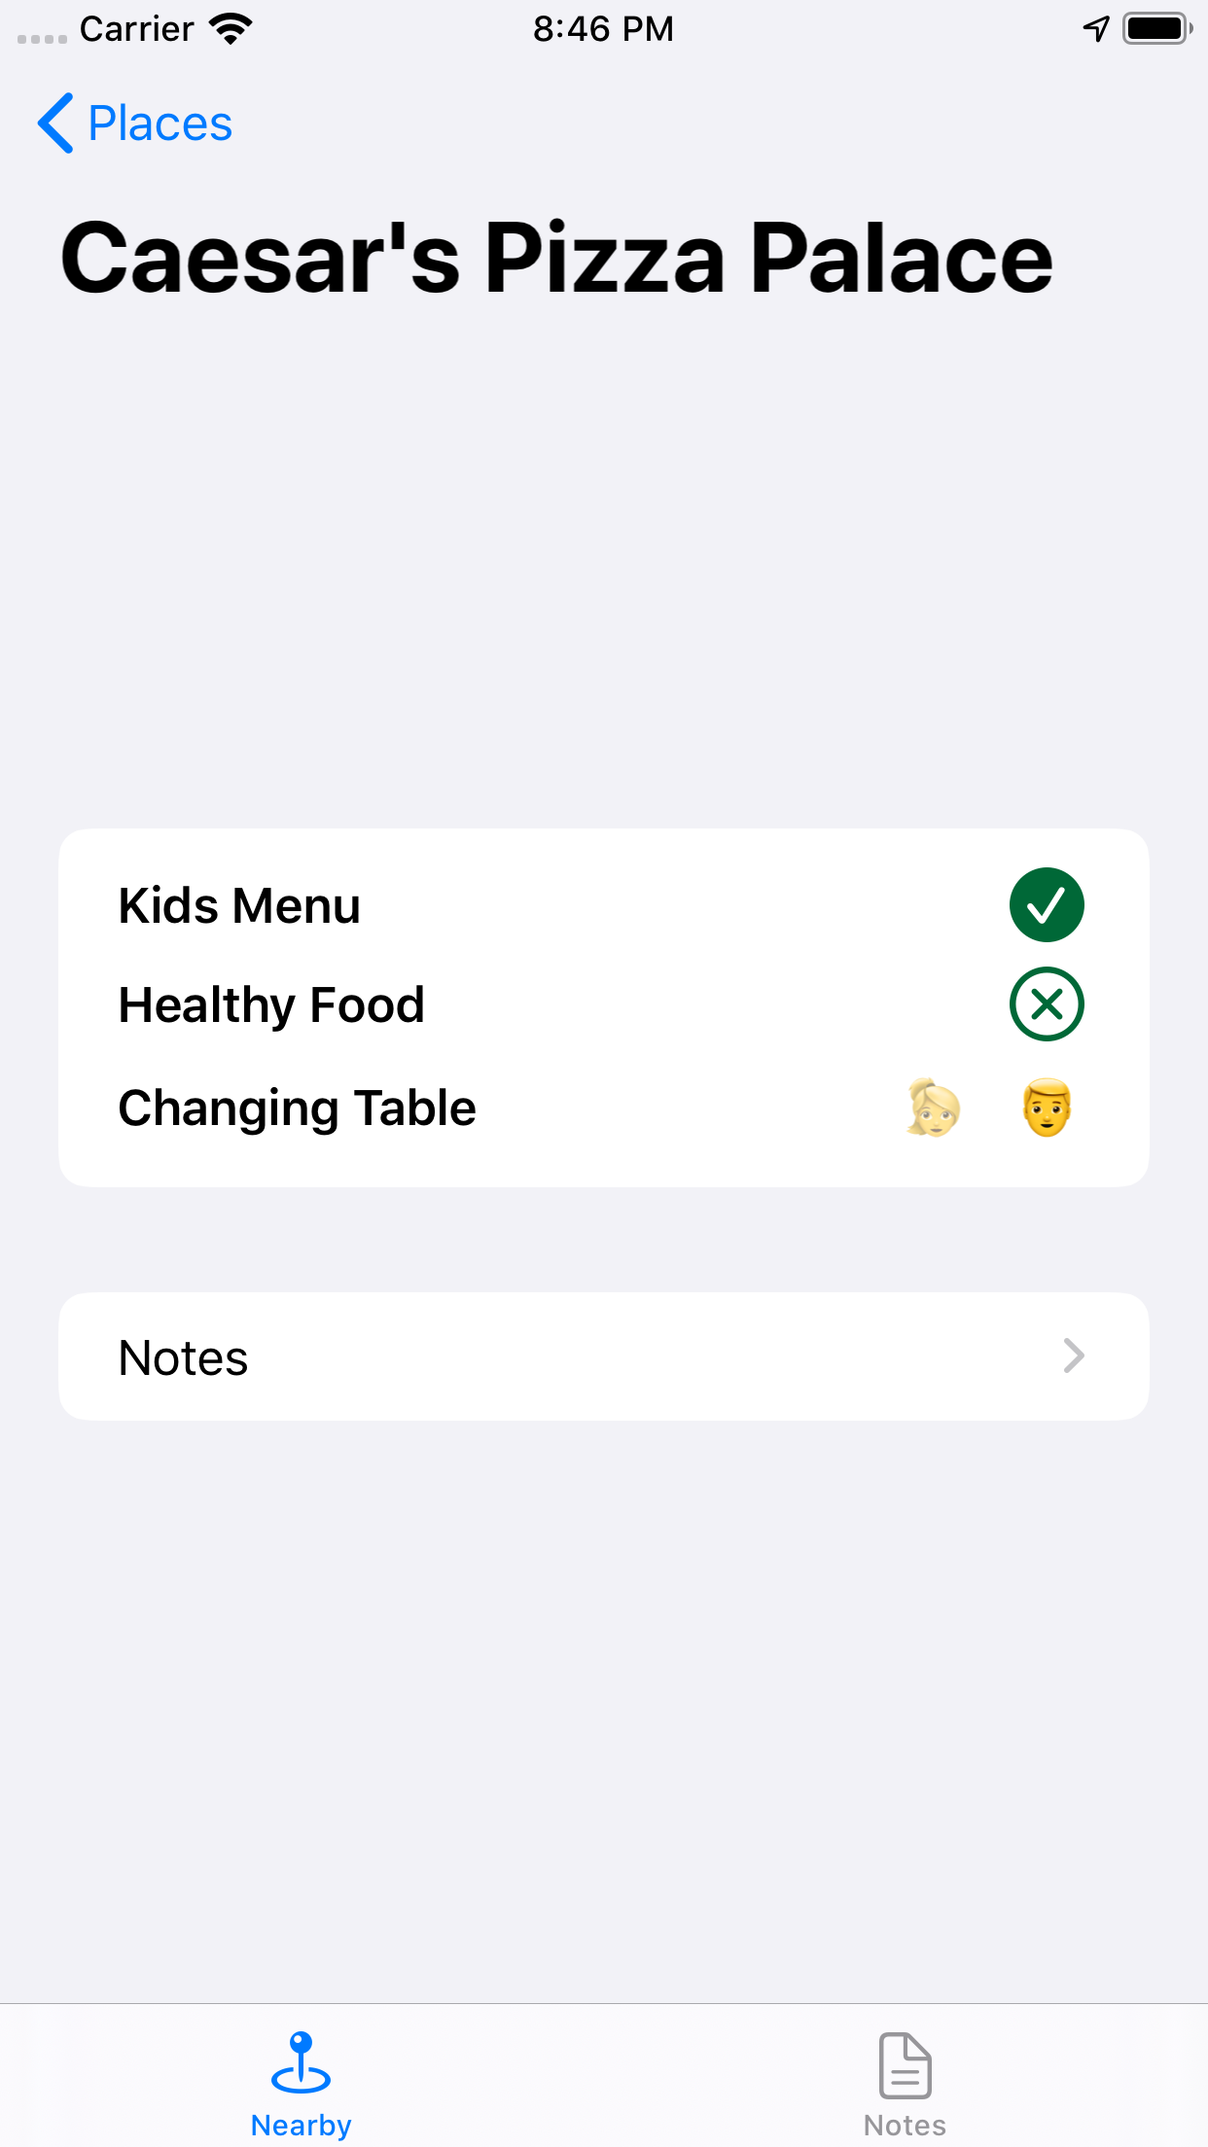
Querying Establishment Records
Things don’t look quite right. You have two items in the table, and if you select one, most of the details are properly loaded.
However, the details screen is missing an image. That’s because the images you uploaded are CKAssets. These require a bit of special handling.

Slide 31
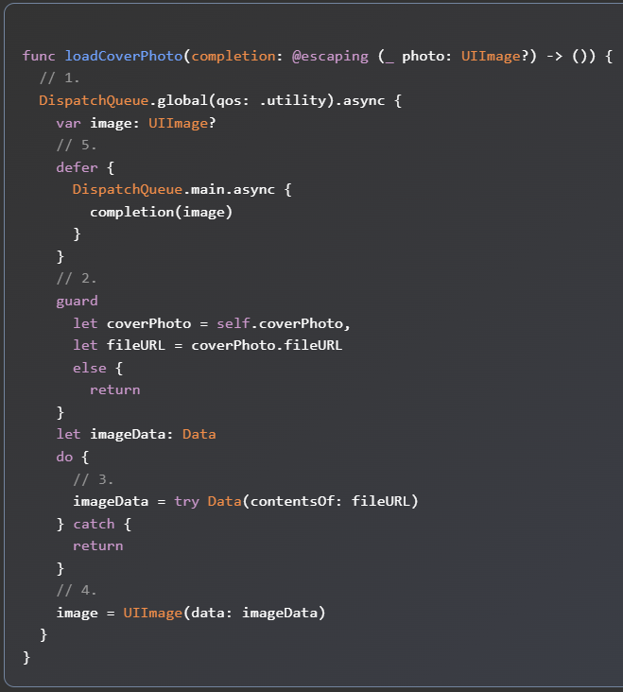
Working With Binary Assets
An asset is binary data, such as an image, that you associate with a record. In your case, your app’s assets are the establishment photos shown in NearbyTableViewController’s table view.
In this section, you’ll add the logic to load the assets that you downloaded when you retrieved the establishment records.
Open Establishment.swift and replace loadCoverPhoto(_:) with the following code:

Slide 32
Working With Binary Assets
This method loads the image from the asset attribute as follows:
Although you download the asset at the same time you retrieve the rest of the record, you want to load the image asynchronously. So, wrap everything in a DispatchQueue.async block.
Check to make sure the asset coverPhoto exists and has a fileURL.
Download the image’s binary data.
Use the image data to create an instance of UIImage.
Execute the completion callback with the retrieved image. Note that the defer block gets executed regardless of which return is executed. For example, if there is no image asset, then image never gets set upon the return and no image appears for the restaurant.

Slide 33
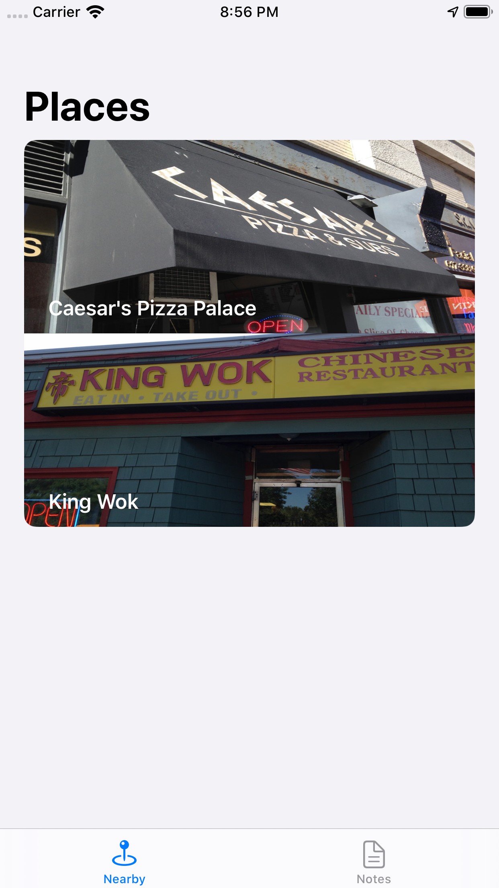
Working With Binary Assets
Build and run. The establishment images should now appear. Great job!

Slide 34
Working With Binary Assets
There are two gotchas with CloudKit assets:
Assets can only exist in CloudKit as attributes on records; you can’t store them on their own. Deleting a record will also delete any associated assets.
Retrieving assets can negatively impact performance because you download the assets at the same time as the rest of the record data. If your app makes heavy use of assets, then you should store a reference to a different type of record that holds just the asset.

Slide 35
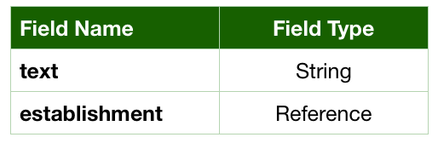
Relationships
It’s important to understand how you can create a relationship between different record types in CloudKit. To do this, you’re going to add a new record type, Note, and create private records that are not in the public database. These records will belong to an Establishment.
Back in the CloudKit dashboard, add the Note type by going to Schema and selecting New Type. Add the following fields and then save:

Slide 36
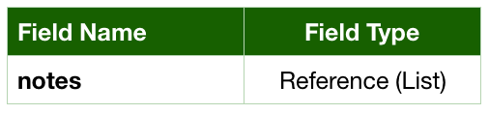
Relationships
Click Edit Indexes and then click Add Index to make recordName queryable.
Next, add a new field to Establishment:
By creating the field notes on Establishment, and establishment on Note, you now have a one-to-many relationship. This means an Establishment can have many notes, but a Note can only belong to one Establishment.

Slide 37
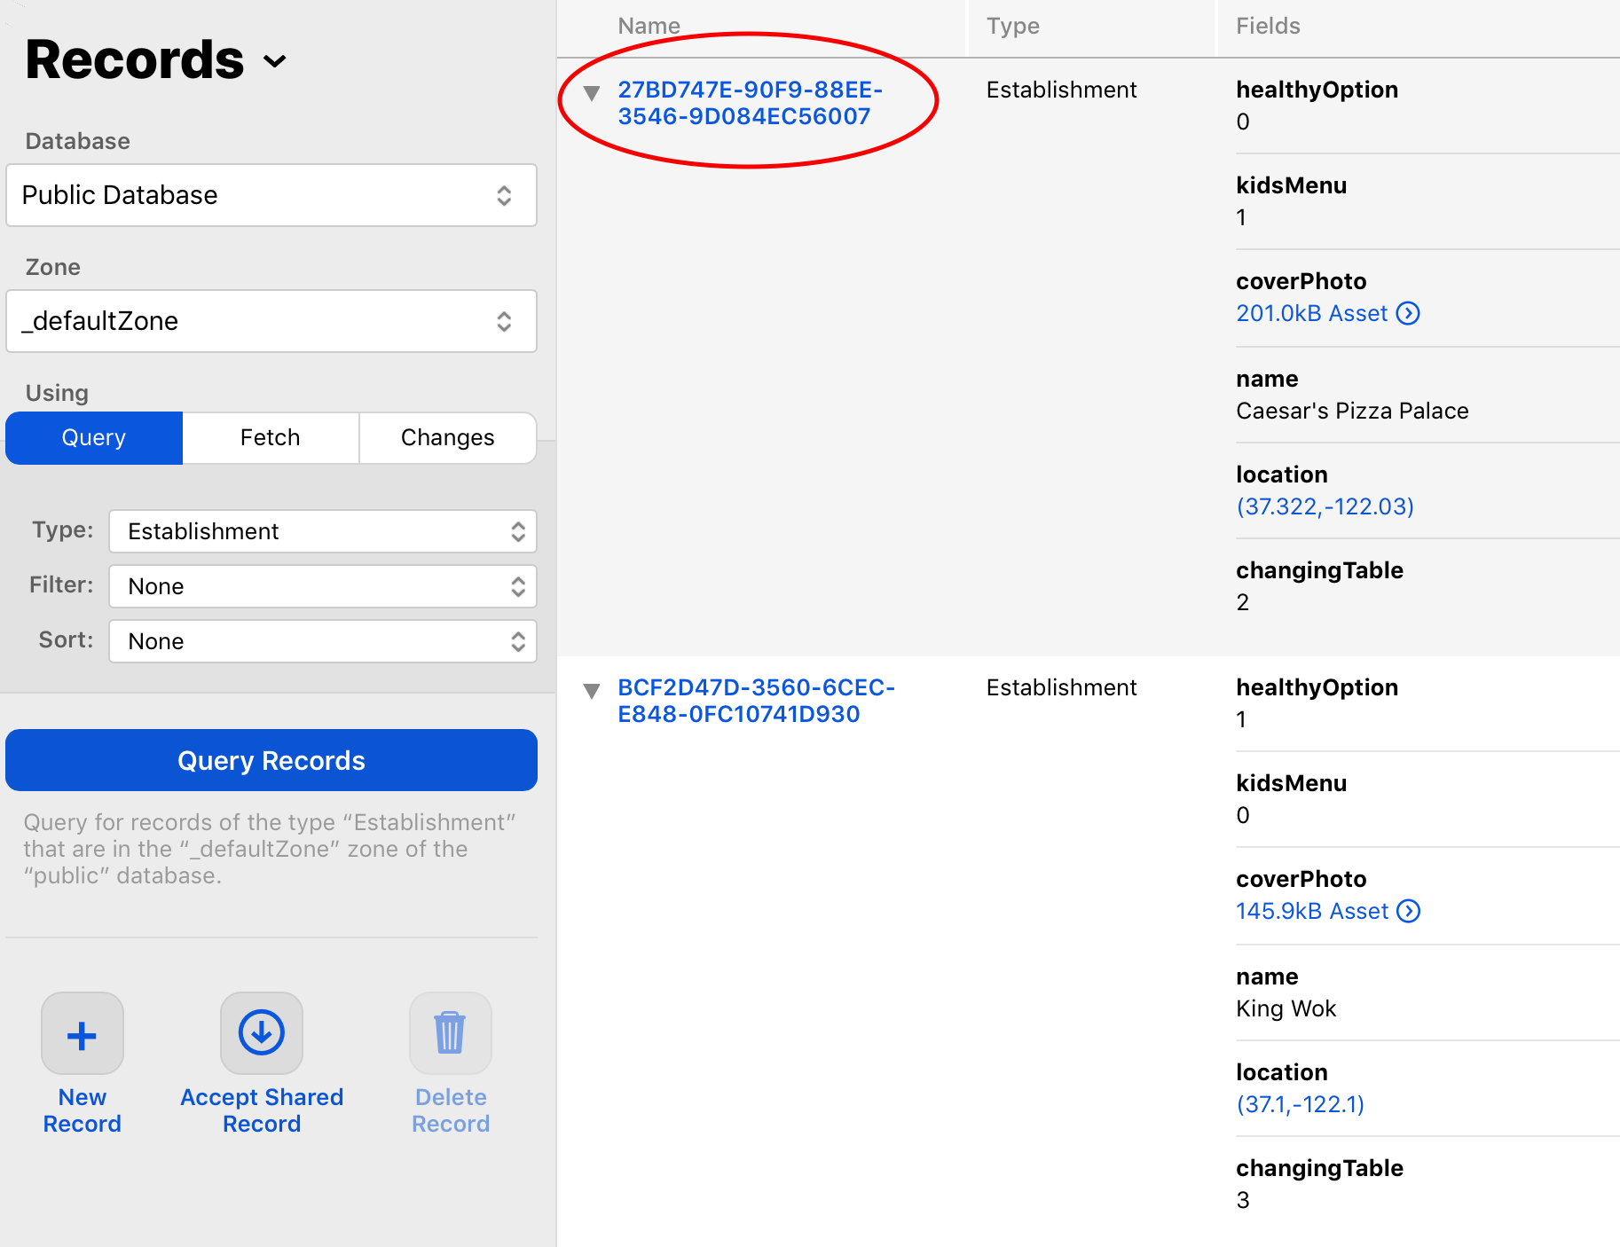
Relationships
Before you continue, you need to get the Name value of an Establishment record.
In the CloudKit dashboard, go back to Data, select Public Database and the type Establishment from the drop-down.
Next, click on Query Records. Make a note of the first item’s Name, like below:

Slide 38
Relationships
Next, create a Note record in the CloudKit dashboard, just like you did for the two Establishment records.
Still in the Data section of the dashboard, select Note from the Type drop-down. However, change Public Database to Private Database and then select New Record.
Now, your record will only be available in your CloudKit database. Then change the following values:
For Establishment, enter the value found in the name field.
Enter anything you’d like for text.
Before you save, copy the value found in the new note’s Name field to make things easier for the next step.

Slide 39
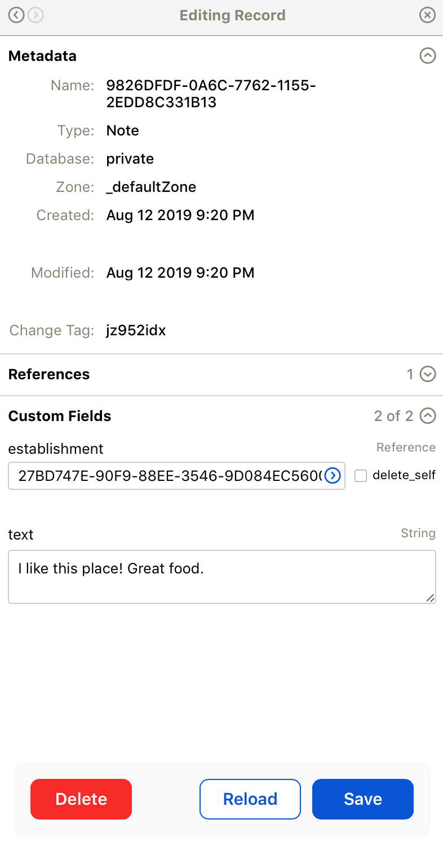
Relationships
Your new record should look like this:
Select Save.

Slide 40
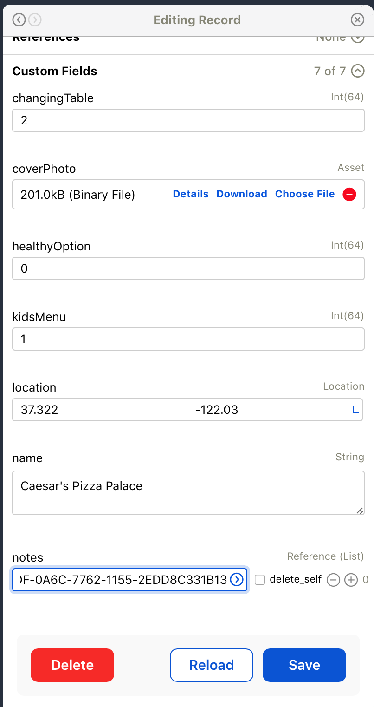
Relationships
Next, query your public Establishments and edit the record whose Name you used for the note.
Select the + button, enter the note’s name that you saved from the previous step, then Save. It should look like this:
You now have a public Establishment record that has a relationship to a private Note record!

Slide 41
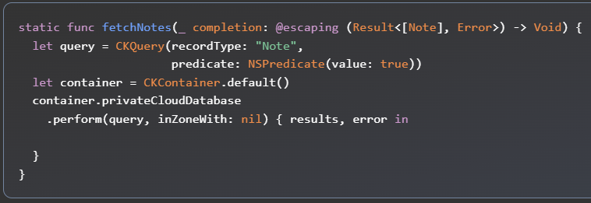
Relationships
To load the notes, open Note.swift, and replace fetchNotes(_:) with the following:
This looks similar to how you query and download establishments.
However, note that the information is now loading from the privateCloudDatabase instead of the public database.
It’s that simple to specify whether you want user-specific or public data in your app.

Slide 42
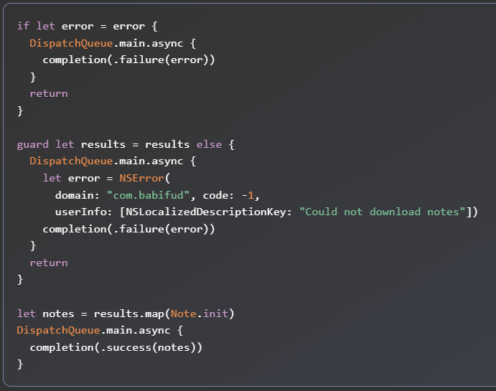
Relationships
Next, add the following inside the closure to get the record’s data, like you did earlier for Establishment:
This code, however, will only work to get all of the user’s notes loaded.

Slide 43
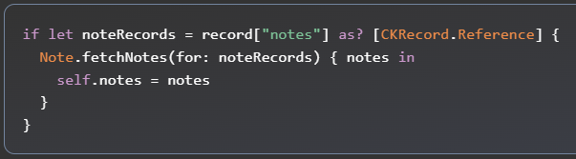
Relationships
To load a note with a relationship to an establishment, open Establishment.swift, and add the following to the end of init?(record:database:):

Slide 44
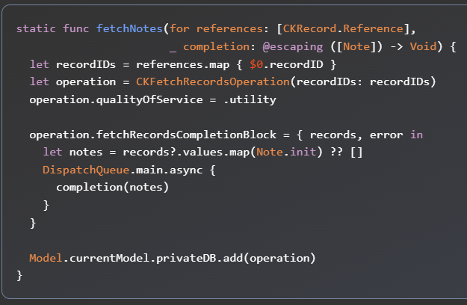
Relationships
This will check to see if your establishment has an array of references, and then load only those specific records. Open Note.swift and add the following method:
Use CKFetchRecordsOperation to easily load multiple records at once. You create it with a list of IDs and set its quality of service to make sure it runs in the background.
Then, set the completion block to pass the fetched notes or an empty array if there’s an error.
To run the operation, call add on the private database.

Slide 45
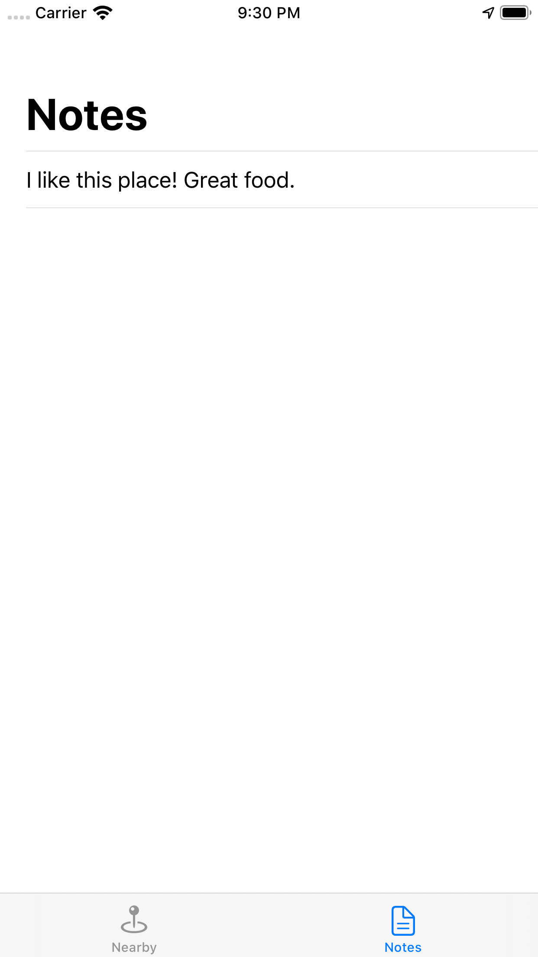
Relationships
Build and run, then go to the Notes tab. You should see that your note has loaded.
Note: Up to this point, you didn’t need to be logged in to iCloud for the app to work. If you are having trouble loading notes, log in under Settings/Sign into your iPhone. Keep in mind, you need to be logged in with the same Apple ID that you used for logging into the CloudKit dashboard. Then, try relaunching the app to see the data load properly.
Also, go to the establishment where you set the note and select Notes. You can see that the other establishment does not load the note.

Slide 46
Troubleshooting Queries
If the data isn’t appearing properly – or isn’t appearing at all – inspect the sample data using the CloudKit dashboard. Make sure all of the records are present, that you’ve added them to the default zone and that they have the correct values.
If you need to re-enter the data, you can delete records by clicking the trash icon.
Debugging CloudKit errors can be tricky. CloudKit error messages often don’t contain a tremendous amount of information.
To determine the cause of the error, you can look at the error code in conjunction with the particular database operation you’re attempting. Using the numerical error code, look up the matching CKErrorCode enum. The name and description in the documentation will help narrow down the cause of the issue.

Slide 47
www.bjitgroup.com
Thank You

